Slide 1

Data Representation
Review video - 5 mins - https://www.youtube.com/watch?v=USCBCmwMCDA

Slide 2

How do computers represent data?
When we look at a computer, we see text and images and shapes.
To a computer, all of that is just binary data, 1s and 0s.
There are 3 different number systems:

Slide 3
Binary Digit
Binary is a number system for computers with only 2 digits 0s and 1s
They are also referred to as Off and On
Binary String
A sequence of binary digits is a Binary String , such as 000011100101

Slide 4

Computers use millions of tiny “switches”, which must be in the ON or OFF positions. This is represented as 1’s and 0’s , called the “Binary Number System”.
Data is stored in the computer in the binary number system. Each digit (1 or 0) in the binary number system is known as a “bit”. This is a single memory unit in the computer system.
ON → 1 → True OFF → 0 → False
The binary system counts in multiples of 2. There are only 2 values used in this system, 0 and 1. It is also known as the base 2 number system.
For eg:
1011 = 1 x 2³ + 0 x 2² + 1 x 2¹ + 1 x 2⁰

Slide 5
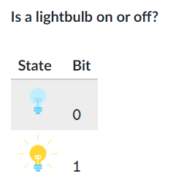
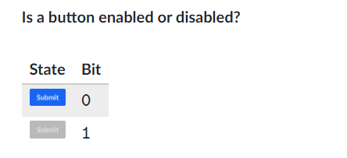
Examples:

Slide 6


4 such bits make a “nibble”.
8 such bits make a “byte”.
A single memory unit (0/1) | 1 Bit
4 Bits | 1 Nibble
8 Bits | 1 Byte
1024 Bytes | 1 Kilobyte
1024 Kilobytes | 1 Megabyte
1024 Megabytes | 1 Gigabyte
1024 Gigabytes | 1 Terabyte
1024 Terabytes | 1 Petabyte
Memory units are classified as follows:

Slide 7
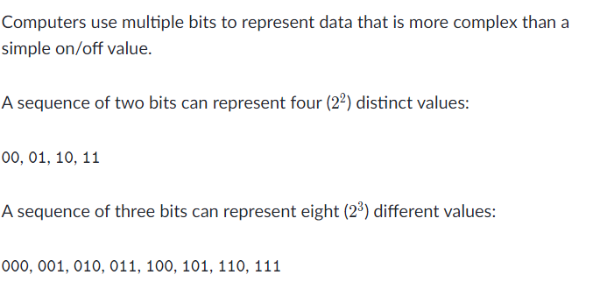
Sequence of bits

Slide 8
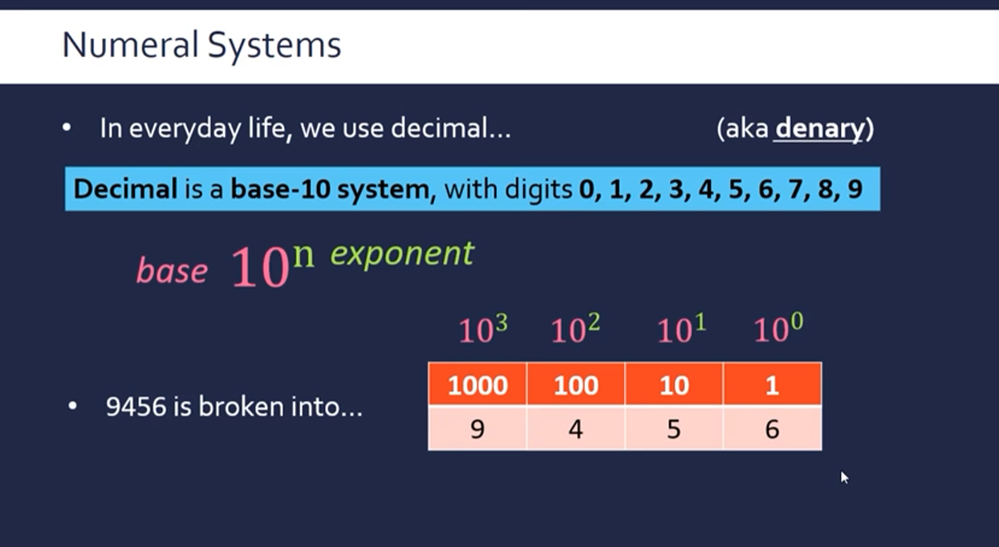
Denary Numbers
Source: https://youtu.be/Ol3PxSpEeT4

Slide 9
Let’s see how the denary and the binary numbers are linked.
Denary | Binary
0 | 0000
1 | 0001
2 | 0010
3 | 0011
4 | 0100
5 | 0101
6 | 0110
7 | 0111
8 | 1000

Slide 10
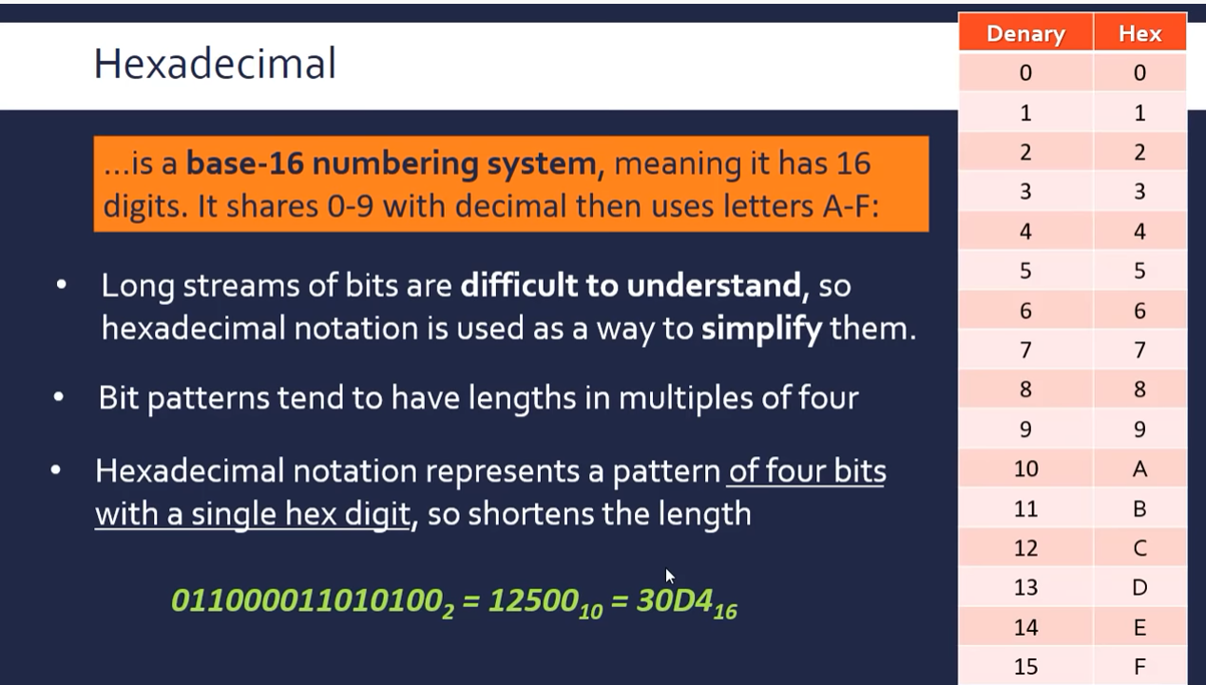
Hexadecimal Numbers
Source: https://youtu.be/Ol3PxSpEeT4

Slide 11
Let’s see how the denary and the hexadecimal numbers are linked.
Denary | Hexadecimal
0 | 0
1 | 1
2 | 2
3 | 3
4 | 4
5 | 5
6 | 6
7 | 7
8 | 8
9 | 9
Denary | Hexadecimal
10 | A
11 | B
12 | C
13 | D
14 | E
15 | F

Slide 12
Conversion between the different number systems

Slide 13
Binary to Denary:
As we know, binary is a base 2 number system. Therefore, each place in a binary number will have its corresponding value, as shown below.
2⁷ 2⁶ 2⁵ 2⁴ 2³ 2² 2¹ 2⁰
1 | 1 | 1 | 0 | 1 | 1 | 1 | 0
To convert this binary number to its corresponding denary, we multiply the digit in the binary number with the value of its place and add them together.
11101110
= 1 x 2⁷ + 1 x 2⁶ + 1 x 2⁵ + 0 x 2⁴ + 1 x 2³ + 1 x 2² + 1 x 2¹ + 0 x 2⁰
= 128 + 64 + 32 + 0 + 8 + 4 + 2 + 0 = 238

Slide 14
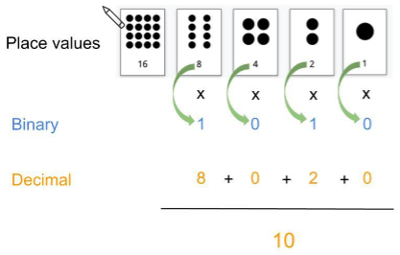
Converting Binary to Decimal
Example - convert 1010 to decimal

Slide 15
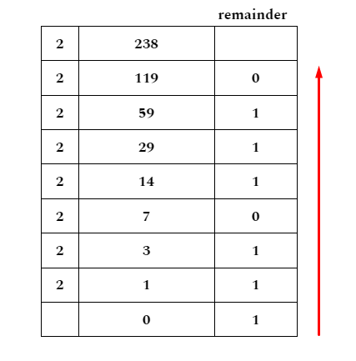
2. Denary to Binary:
To convert denary to binary, we divide the denary number by 2 continuously until the quotient is 0.
All the remainders that we get in this process, written in reverse, gives you the corresponding binary number.
238 in denary = 11101110 in binary

Slide 16
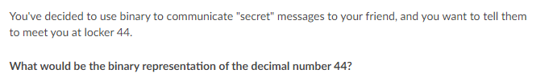

Slide 17
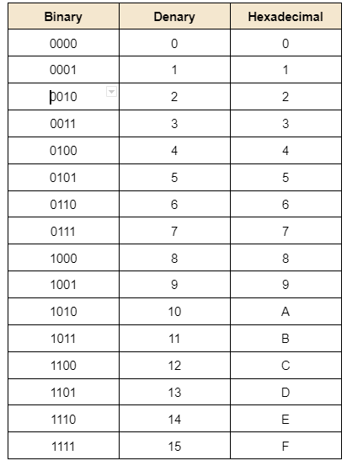
3. Binary to Hexadecimal
To convert a binary number to its corresponding hexadecimal,
Step 1 : Split the binary number into groups of 4 digits, starting from right, moving to left. If the last group has less than 4 digits, fill it with 0’s from the left.
Step 2: We find the corresponding hexadecimal number according to the following table.

Slide 18
11101110
1110 | 1110
E | E
10000111111101
10 | 0001 | 1111 | 1101
0010 | 0001 | 1111 | 1101
2 | 1 | F | D

Slide 19
4. Hexadecimal to Binary
Similarly, to convert the hexadecimal to binary, we write down the 4 digit binary code which corresponds to each digit in the hex number.
45A
4 | 5 | A
0100 | 0101 | 1010

Slide 20
5. Hexadecimal to Denary
To convert a hexadecimal number to denary, we multiply each digit by the value of its place and then add it all together.
C8F
= 12 x 16² + 8 x 16¹ + F x 16⁰
= 12 x 256 + 8 x 16 + 15 x 1
= 3072 + 128 + 15
= 3215

Slide 21
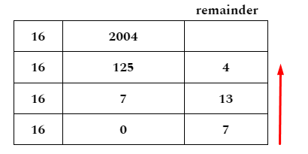
6. Denary to Hexadecimal
Just like we convert denary to binary by dividing continuously by 2, here we shall convert denary to hexadecimal by continuously dividing by 16.
13 in denary = D in hexadecimal
So,
2004 in denary = 7D4 in hexadecimal

Slide 22
Quiz -
https://forms.gle/WdewPZzwsvdortXt8

